Slide 1
Features of main groups -vertebrates
Wenting Chai

Slide 2
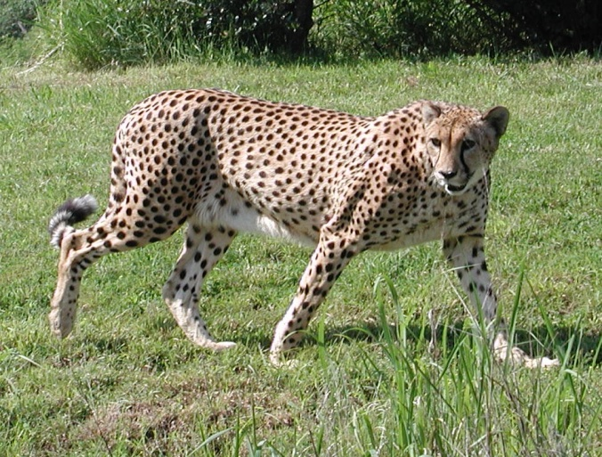
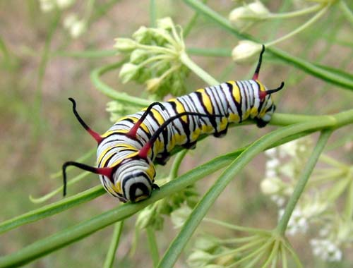
1-Animals
Animals are spilt into two major groups:
Vertebrates
Invertebrates

Slide 3
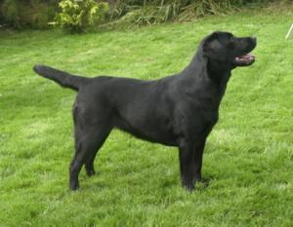
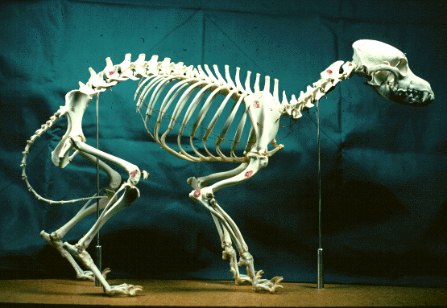
1.1 Vertebrates
Vertebrates make up about 4% of all described animal species.

Slide 4
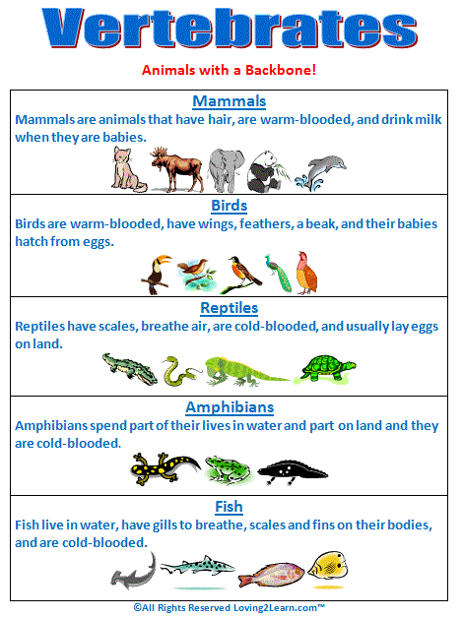

Slide 5
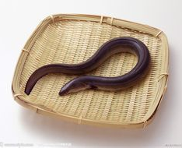
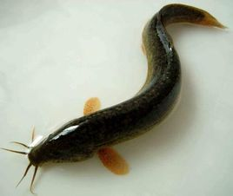
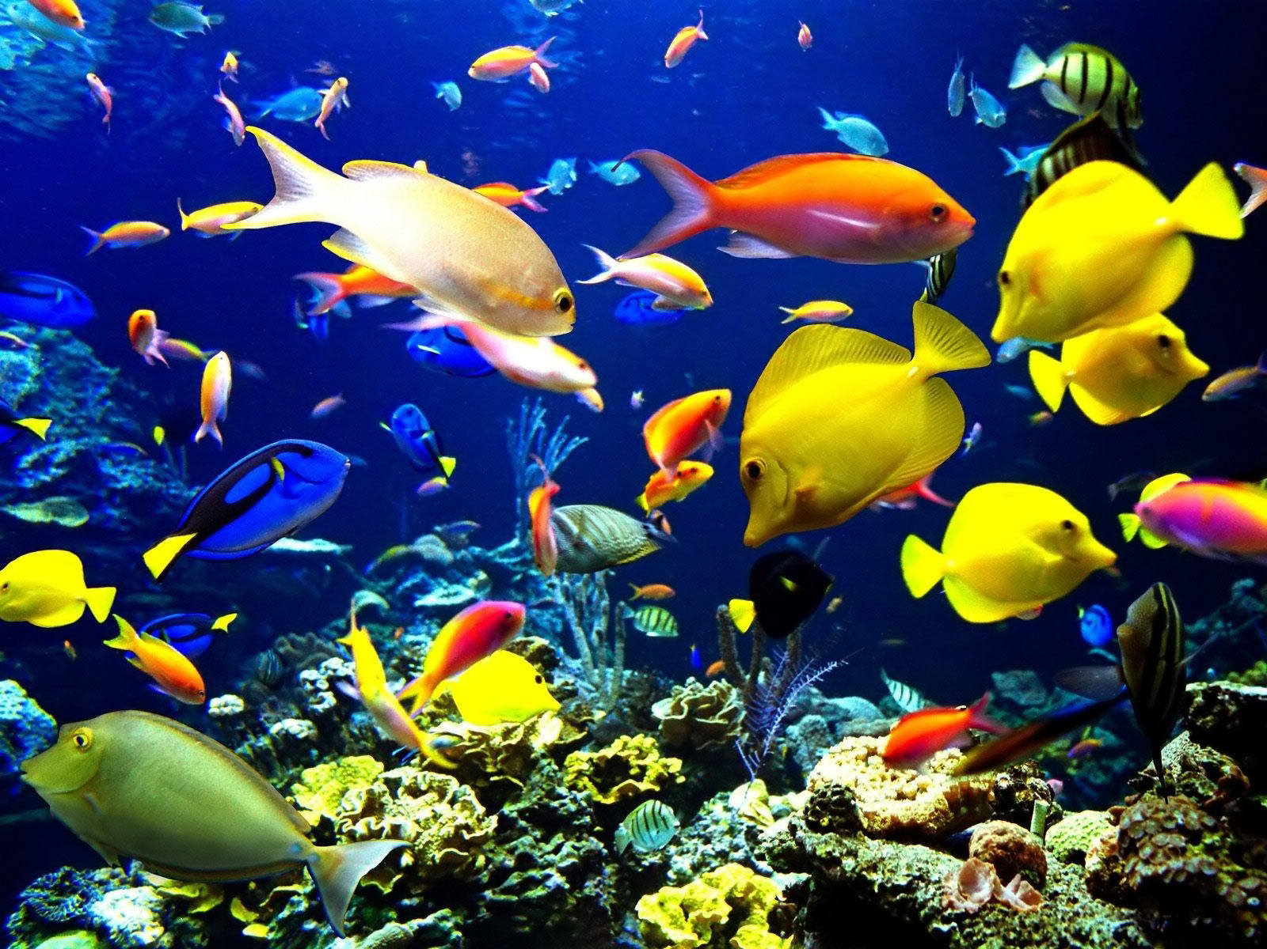
Fish
loach
eel
Notes:
A.鳝鱼，硬骨鱼纲-合鳃鱼目/科-黄鳝属；B.泥鳅，硬骨鱼纲-鲤形目-鳅科

Slide 6
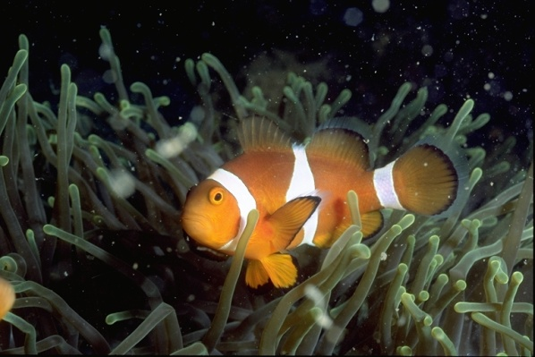
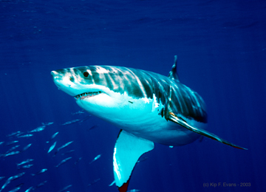


Fish
Fish were the earliest vertebrates to appear on Earth, having evolved more than 500 million years ago.
At 27,000 species, fish exhibit greater species diversity than any other group of vertebrates.

Slide 7
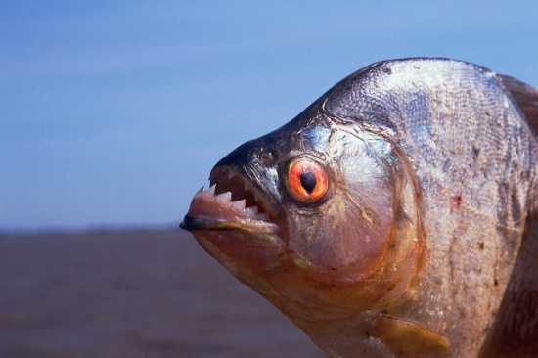
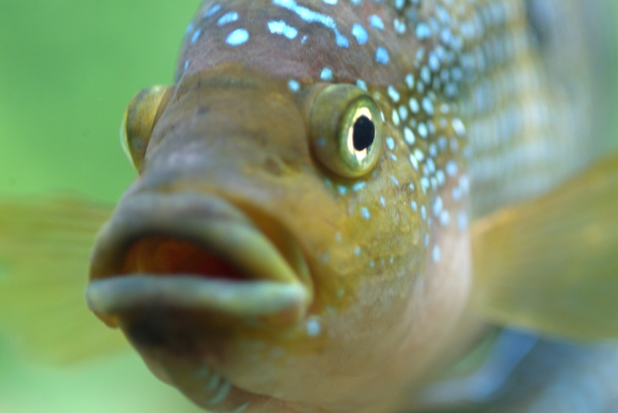
Fish
Skin: scaly skin
Breathe: Through gills
Structures for movement: Fins, lack limbs with digits
Chambers in their heart: 2
Reproduction: Lay eggs in the water
Organ that keeps them afloat: Swim bladder
Body temperature regulation: Cold-blooded/ ectothermic

Slide 8
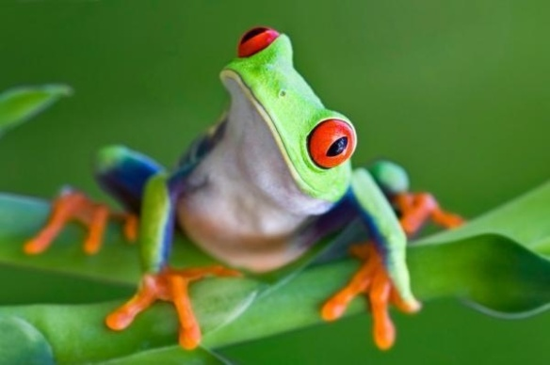
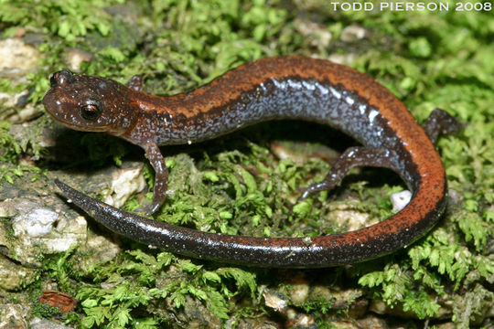
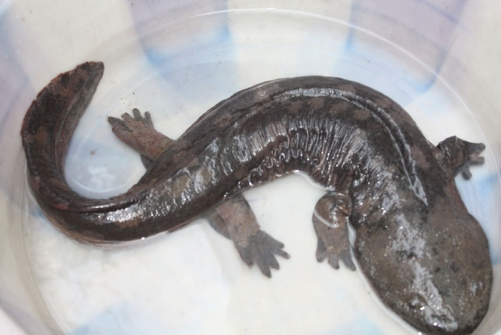
Amphibians
Frog
Newt
Amphibians are ectothermic vertebrates, nearly 90% of which are frogs.
Amphibians include frogs, toads, newts, salamanders, etc.
The young generally undergo metamorphosis from larva with gills to an adult air-breathing form with lungs. Amphibians use their skin as a secondary respiratory surface.
Giant salamander
Notes:
1.Axolotl, [脊椎] 美西螈 A newt is an aquatic amphibian of the family Salamandridae, although not all aquatic salamanders are considered newts.

Slide 9
Amphibians
Although most adult amphibians live on land, they always go back to the water to breed. On land, amphibians are restricted to moist habitats because of the need to keep their skin damp.
Characteristics:
1) skin: vertebrates with moist, scale-less skin, lack any skin coverings such as fur, scales or feathers
2) reproduction: eggs laid in water, larva lives in water
3) adult often lives on land, even as adults, most frogs and other amphibians must stay close to water
4) Breathing: larva has gills, adult has lungs
Notes:
1.大鲵，两栖纲-有尾目-隐鳃鲵科-大鲵属。

Slide 10
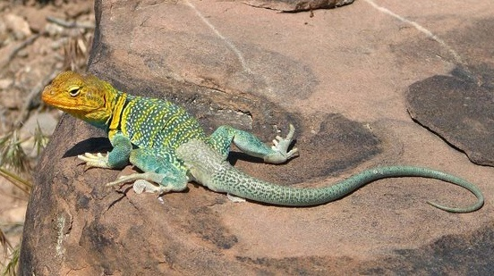
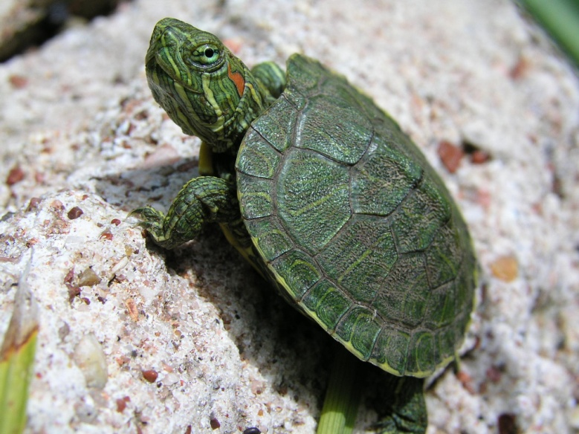
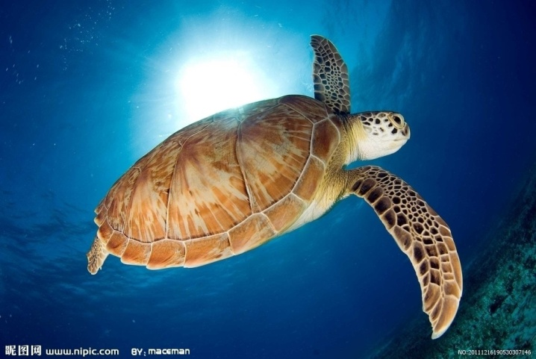
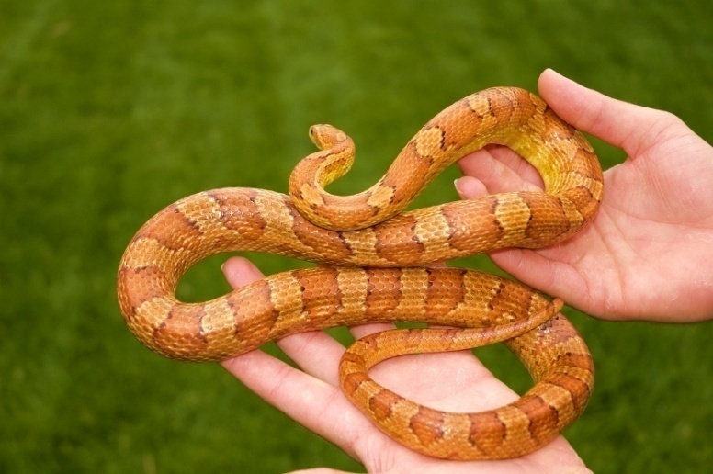
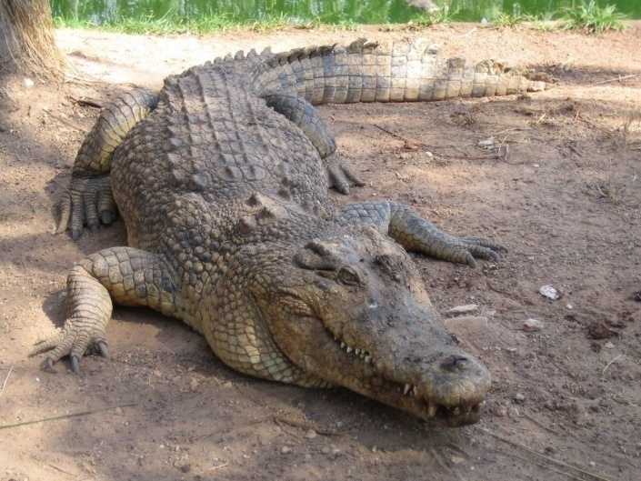
Reptiles
Notes:
Turtle-in water

Slide 11
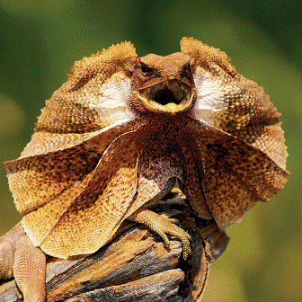
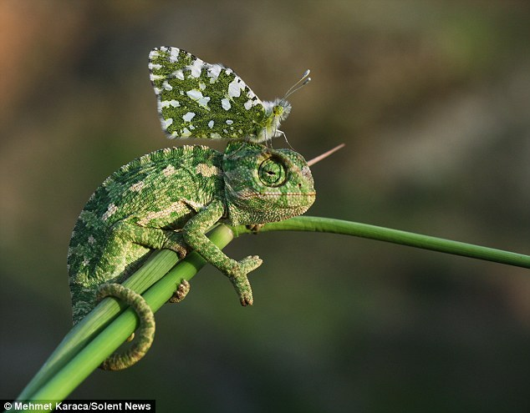
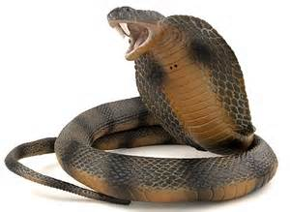
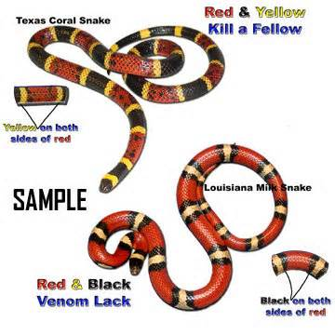
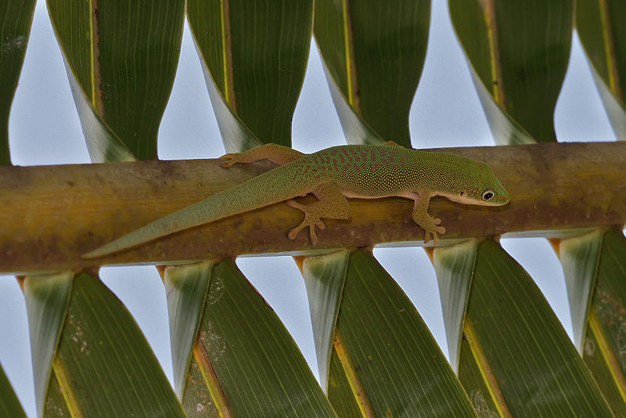
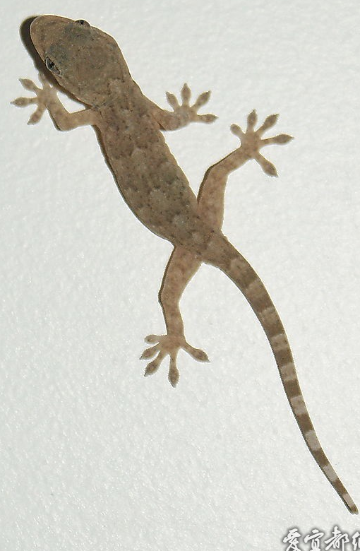
Defense strategy
Notes:
Camoouflage, mimicry, imitate, look large, hiss, play dead, venom,shedding tail, gecko,

Slide 12
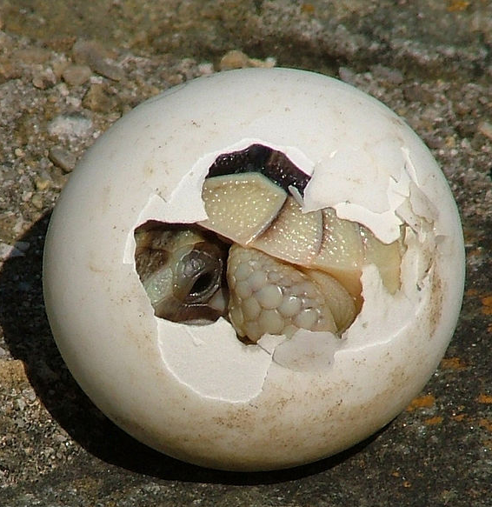
Reptiles
Reptiles do not need to go back to the water to breed because their eggs have a waterproof shell which stops them from drying out.
Characteristics:
1) covering: dry, protective scales
2) lay amniotic eggs with rubbery/ leathery shells
3) cold-blooded because they can't regulate their own body temperature
e.g. crocodiles, lizards, snakes, turtles and tortoise

Slide 13
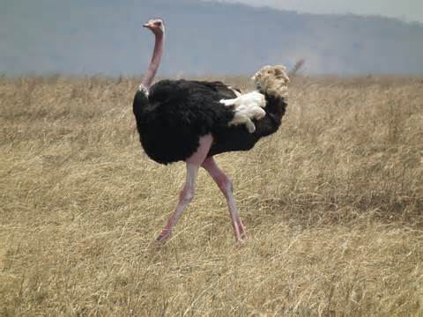
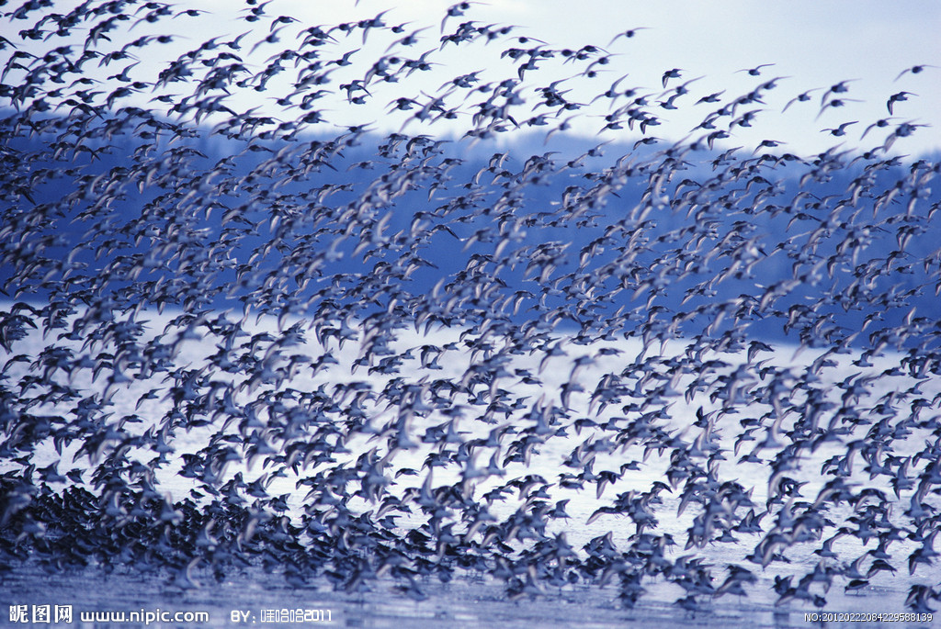
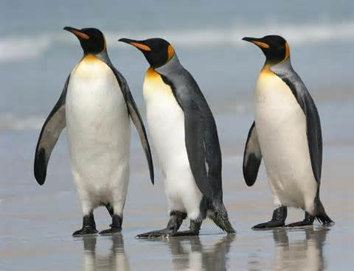
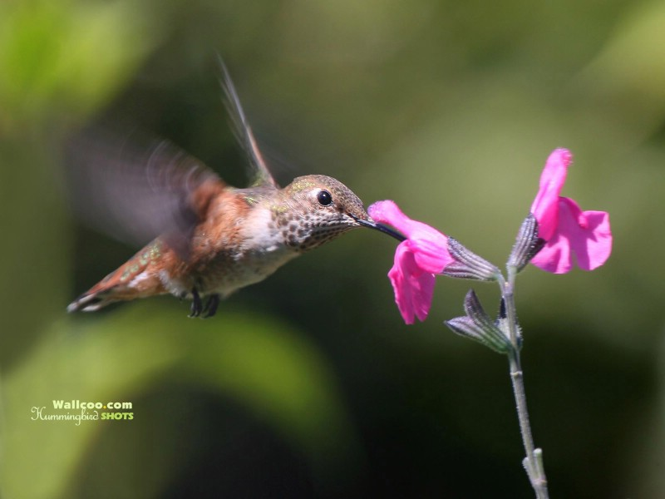
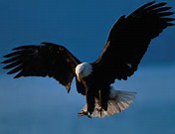
Birds/ Aves
penguin
ostrich
hummingbird
eagle

Slide 14
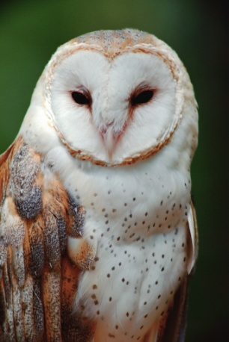
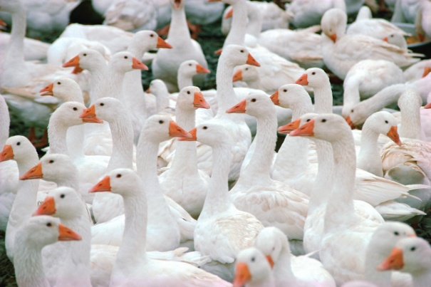
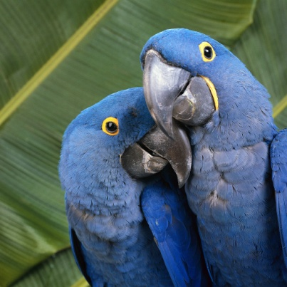
Birds
Three ways that flying is useful: escape predators, find food, and migrate
Have bodies specially adapted for flight :
Adaptations for flight: tiny holes in bones to make them lighter, streamlined shape, lightweight beak, & no teeth
Fly?

Slide 15
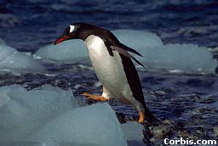
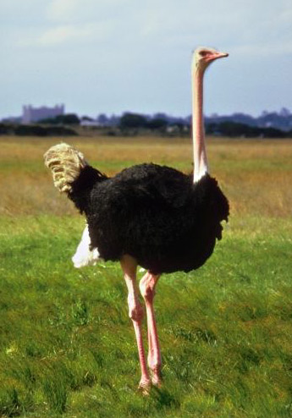
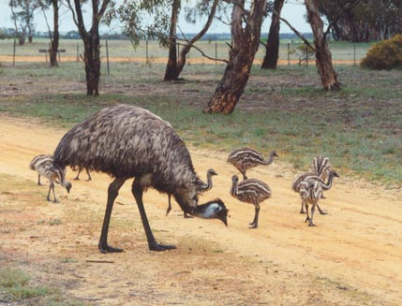
Birds who do NOT fly!
Penguins
Ostriches
Emu

Slide 16
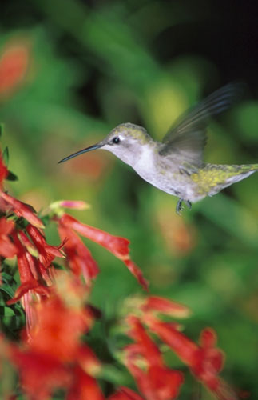
Smallest / Largest
Hummingbird
Ostrich

Slide 17
Birds
The birds, like reptiles, lay eggs with waterproof shells.
Characteristics:
1) with feathers, Down feathers to keep warm
Contour feathers to fly
2) forelimbs have become wings
3) lay eggs with hard shells
4) homeothermic/ warm-blooded
5) have a beak, rather than teeth
6) heart has four chambers
getting oxygen: though lungs

Slide 18
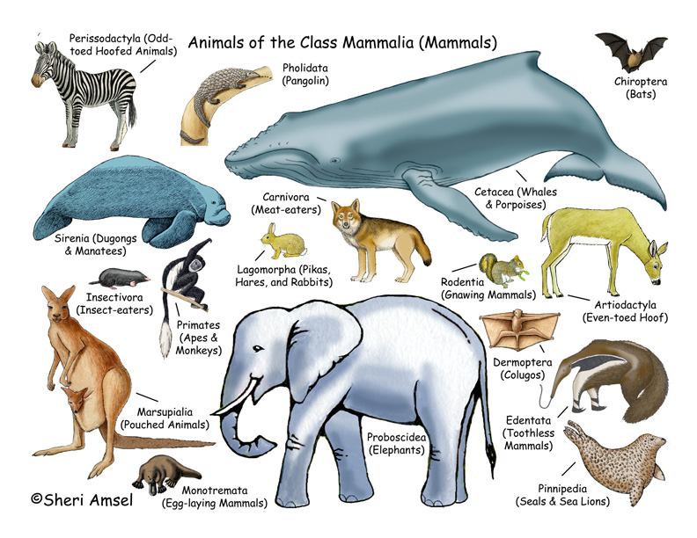
horse, rhinoceros
Mammals
cat, dog, lion, bear, panda
cattle, sheep, deer, camel, pigs, hippo

Slide 19
Mammals
Characteristics:
1) have hair, sweat glands, hair follicle
2) have a placenta, give live birth
3) young feed on milk from mammary glands
4) homeothermic/ warm-blooded
5) have a diaphragm, which separates thorax and abdomen
6) heart has 4 chambers
7) have different types of teeth(incisors, canines, premolars and molars)
8) cerebral hemisphere are very well developed, mammals have larger brains and seem to be the most capable learners.
9) three middle ear bones/ external ear

Slide 20
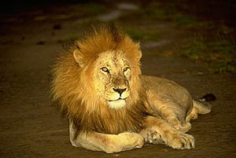
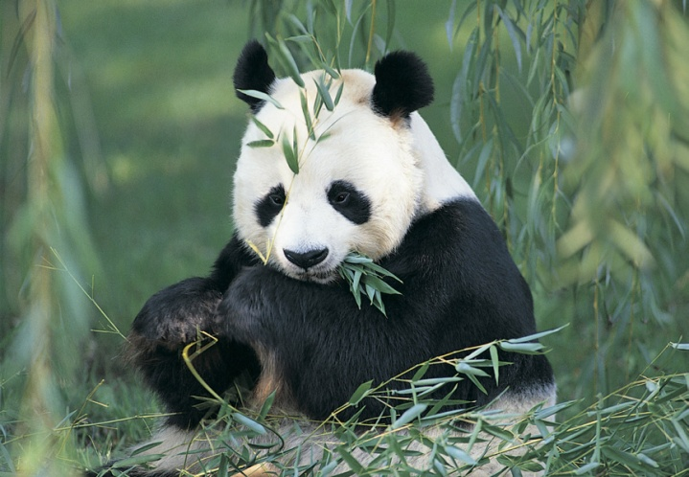
Mammals
Monotremes: lay eggs, but still has mammary glands and produces MILK for young, only 5 species.
Marsupials: pouched mammals that give live birth and babies crawl into pouches until matured. e.g. The kangaroo
Placentals: give live birth; baby attached with umbilical cord
Except for the five species of monotremes egg-laying mammals), all modern mammals give birth to live young. Most mammals, belong to the placental group.

Slide 21
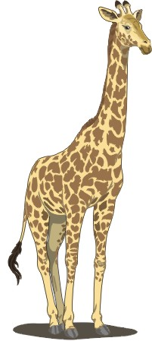
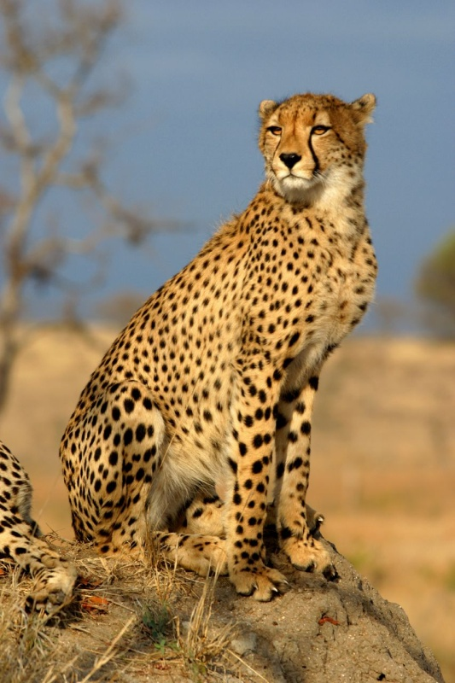
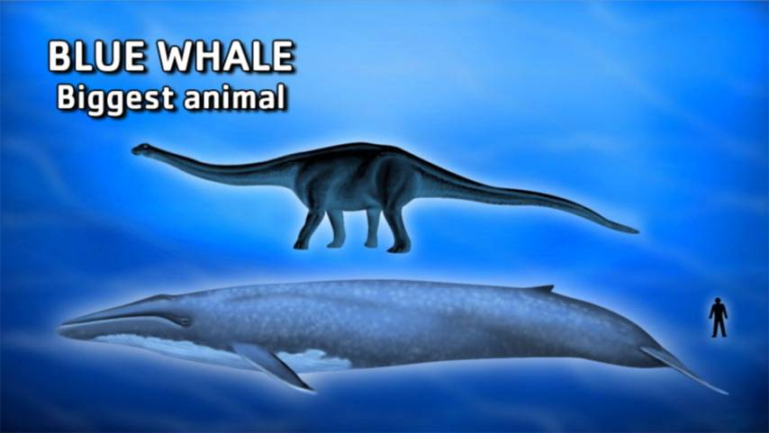
Record-holder
The biggest:
blue whale , at 30 metres in length and 190 tonnes
The tallest:
giraffe
The fastest:
cheetah

Slide 22
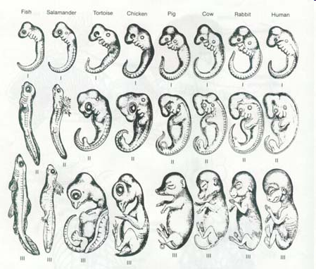

Slide 23
FUN!

Slide 24
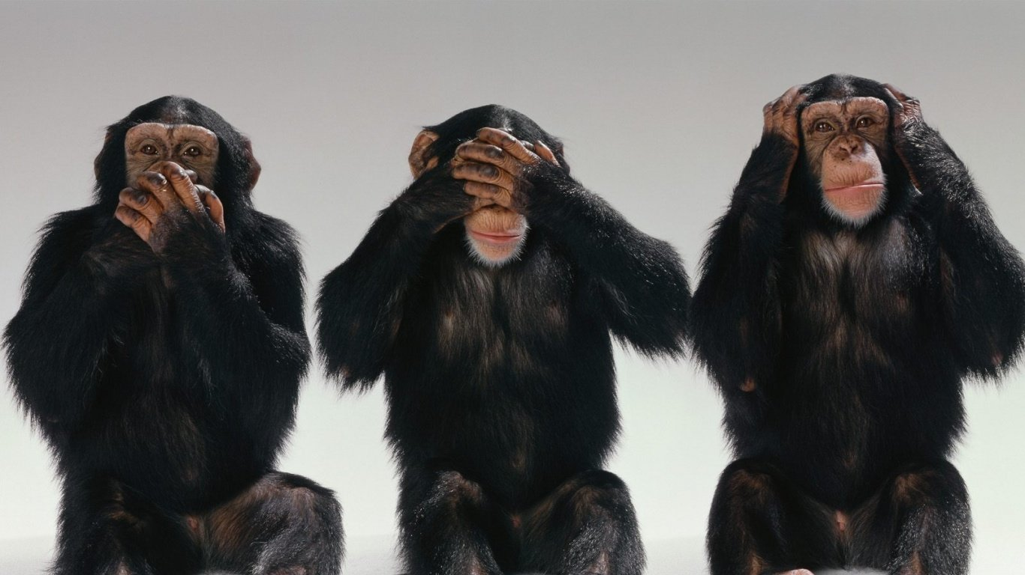
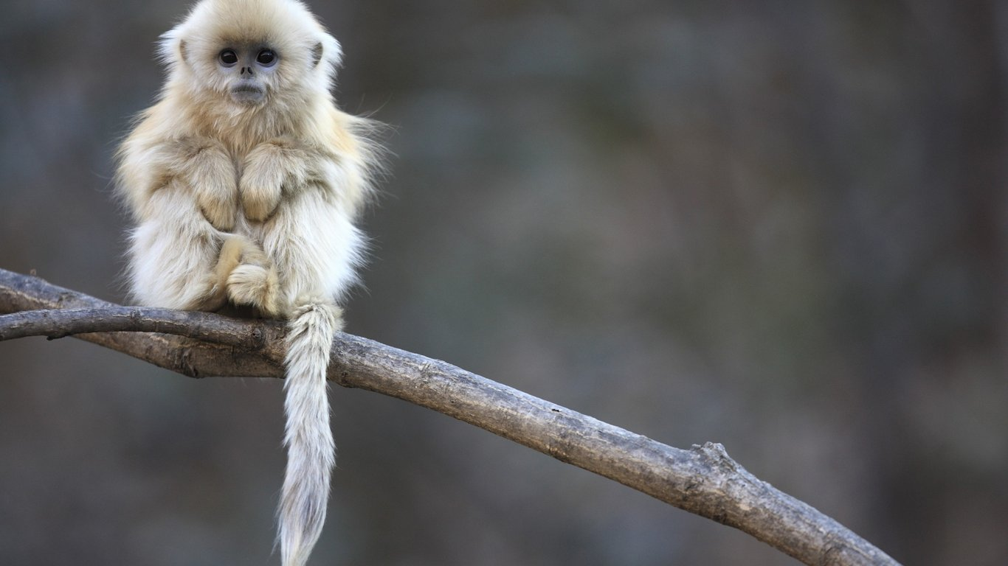
Apes, Class Mammals

Slide 25
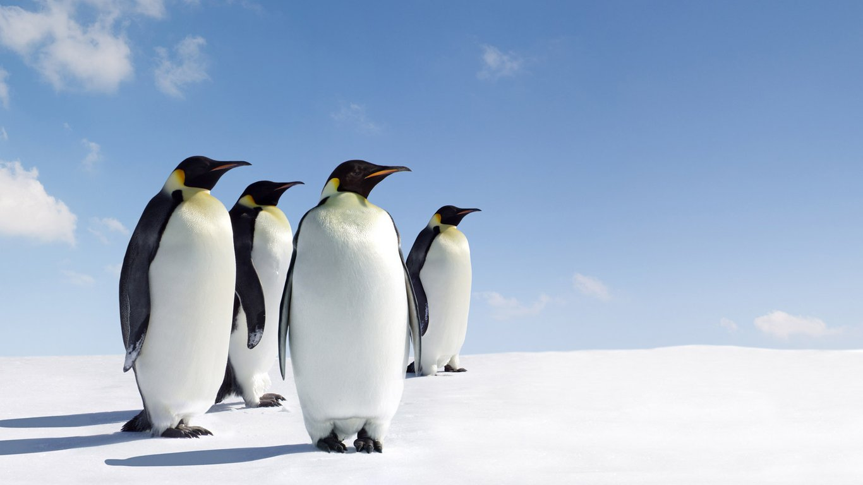
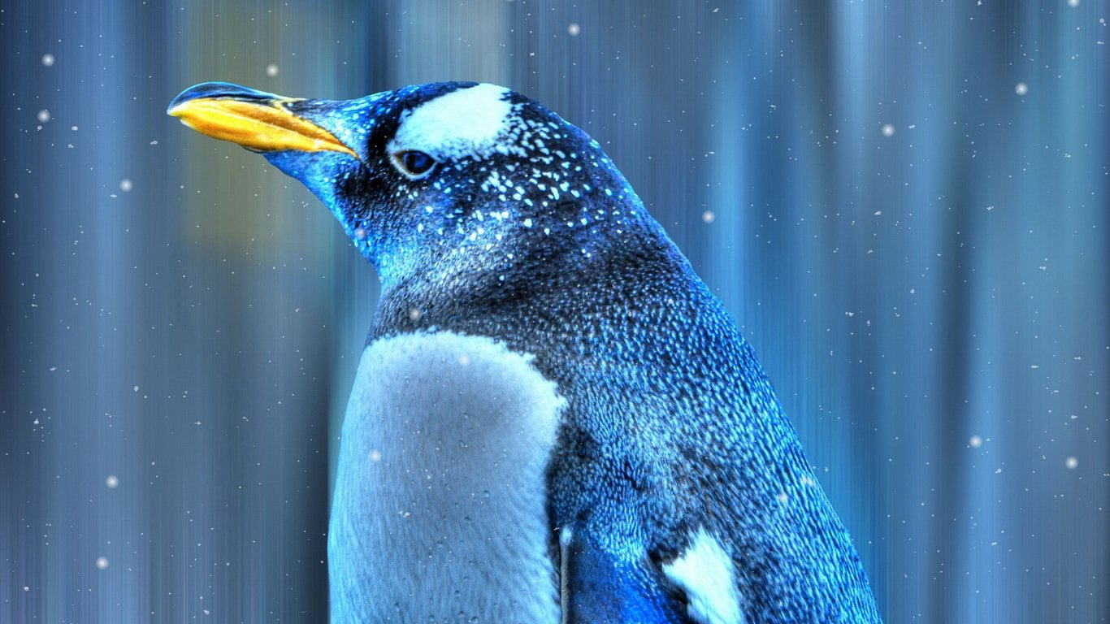

Penguin, Class Birds

Slide 26

Tortoise, Class Reptiles

Slide 27

Frogs, Class Amphibians

Slide 28


Panda, Class Mammals

Slide 29

Snake, Class Reptiles

Slide 30


Eagle, Class Birds

Slide 31

Rat, Class Mammals

Slide 32

Elephant, Class Mammals

Slide 33

Duck, Class Birds

Slide 34

Squirrel, Class Mammals

Slide 35

Peacock, Class Birds

Slide 36

Dog, Class Mammals

